Slide 1



BioCADDIE Harvester Project: Distributed Data Discovery using GitHub, YAML and Markdown
BioCaddie All-Hands
Denver, Sep 2016
Chris Mungall
Lawrence Berkeley National Laboratory

Slide 2

Models of metadata curation
Retrospective
Curated post-submission
At time of submission
Prospective
As part of the data generation and analysis phase
Observation: a significant minority of scientists are using cloud-based social coding repositories like GutHub to manage data files and ancillary artifacts
Goal: make metadata capture part of the process for this group of investigators
BioCADDIE-GYM
Notes:
Can GitHub/GitLab etc be considered part of the commons

Slide 3
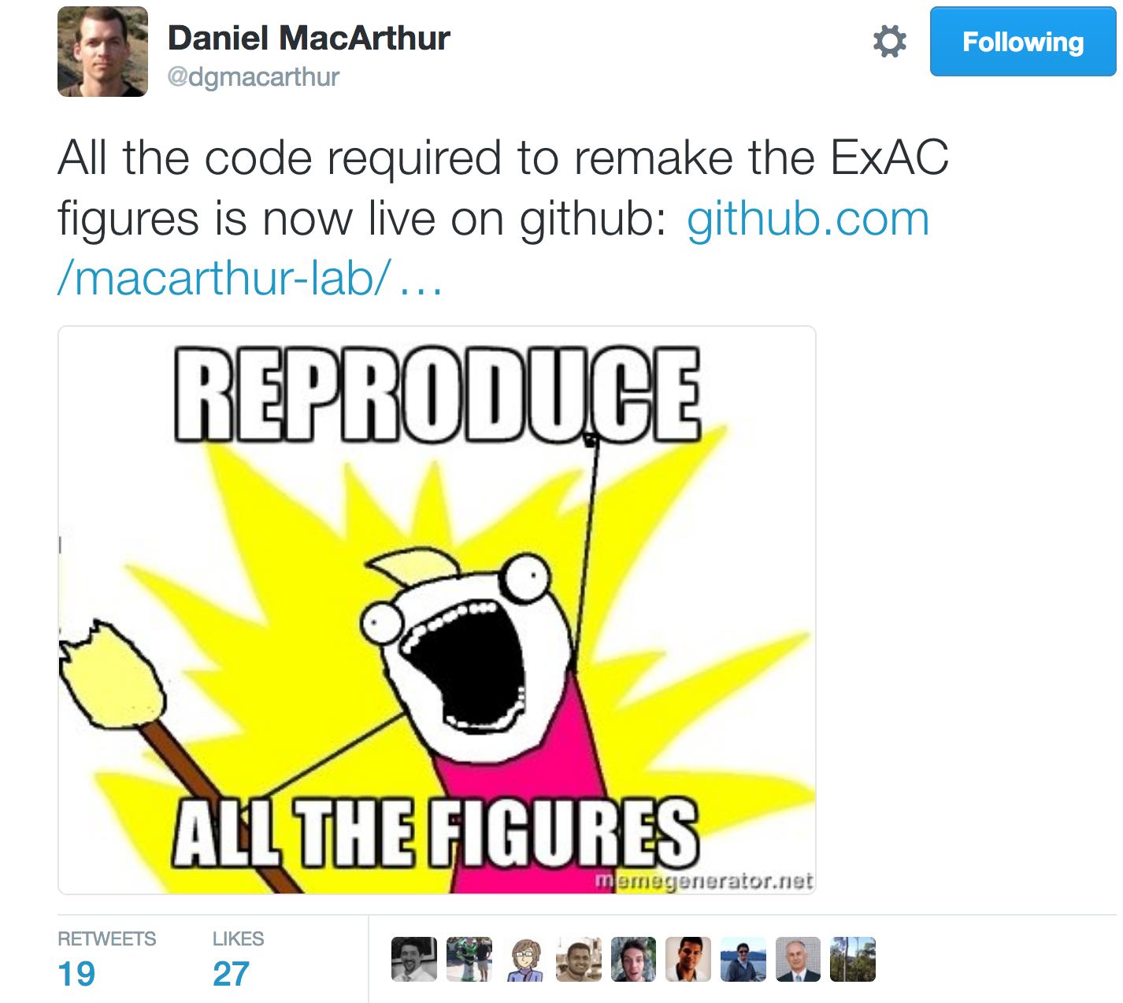

Slide 4
BioCADDIE-GYM: System walkthrough
Instant creation of repository from template
Describe data in YAML
Local publishing via GitHub pages
Harvesting and querying

Slide 5
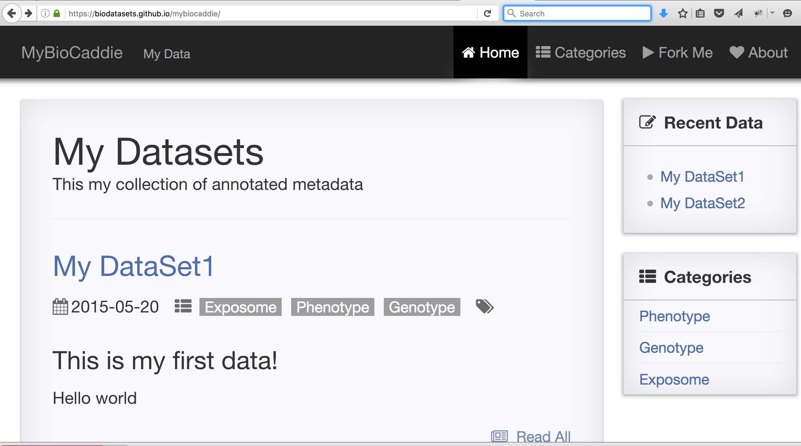
https://biodatasets.github.io/mybiocaddie/
http://bit.ly/mybiocaddie
Template Site

Slide 6
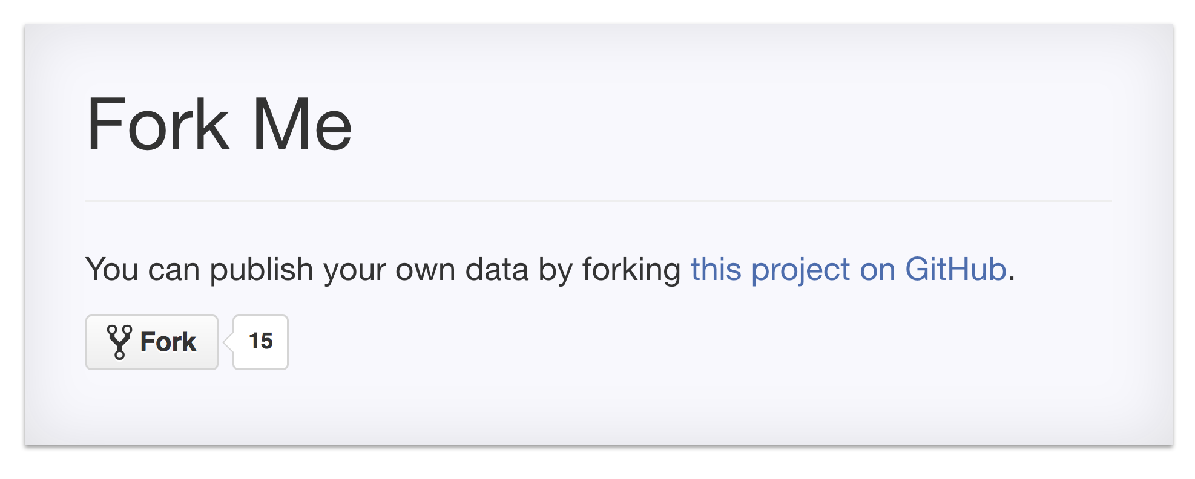

Slide 7
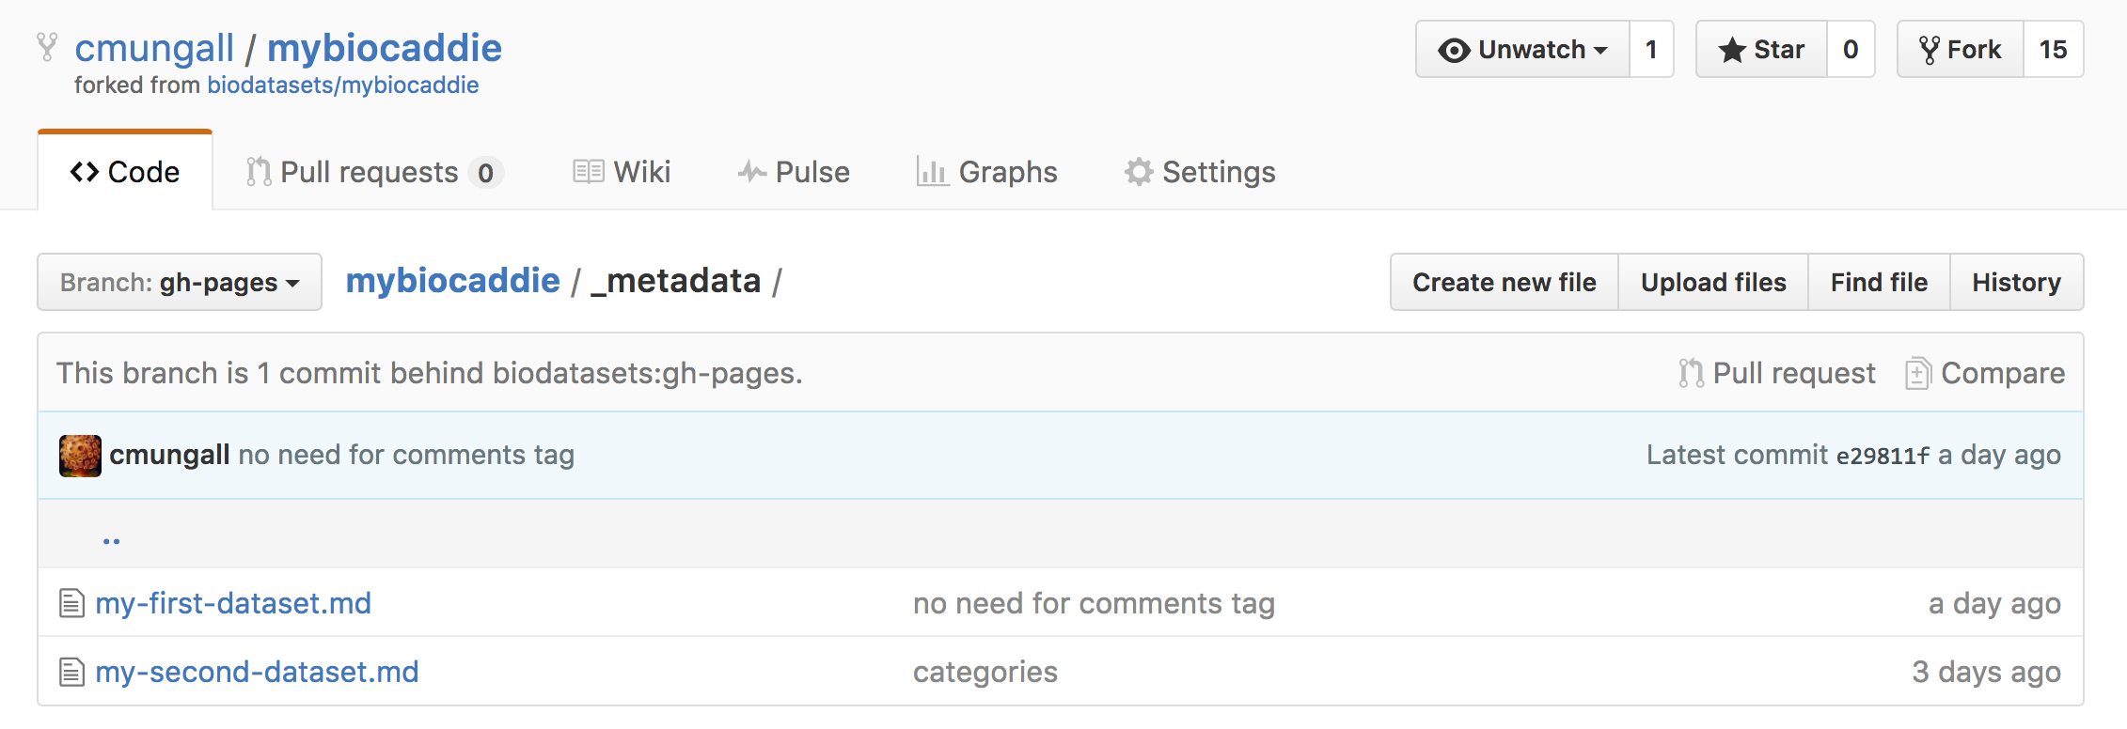
Customize these

Slide 8
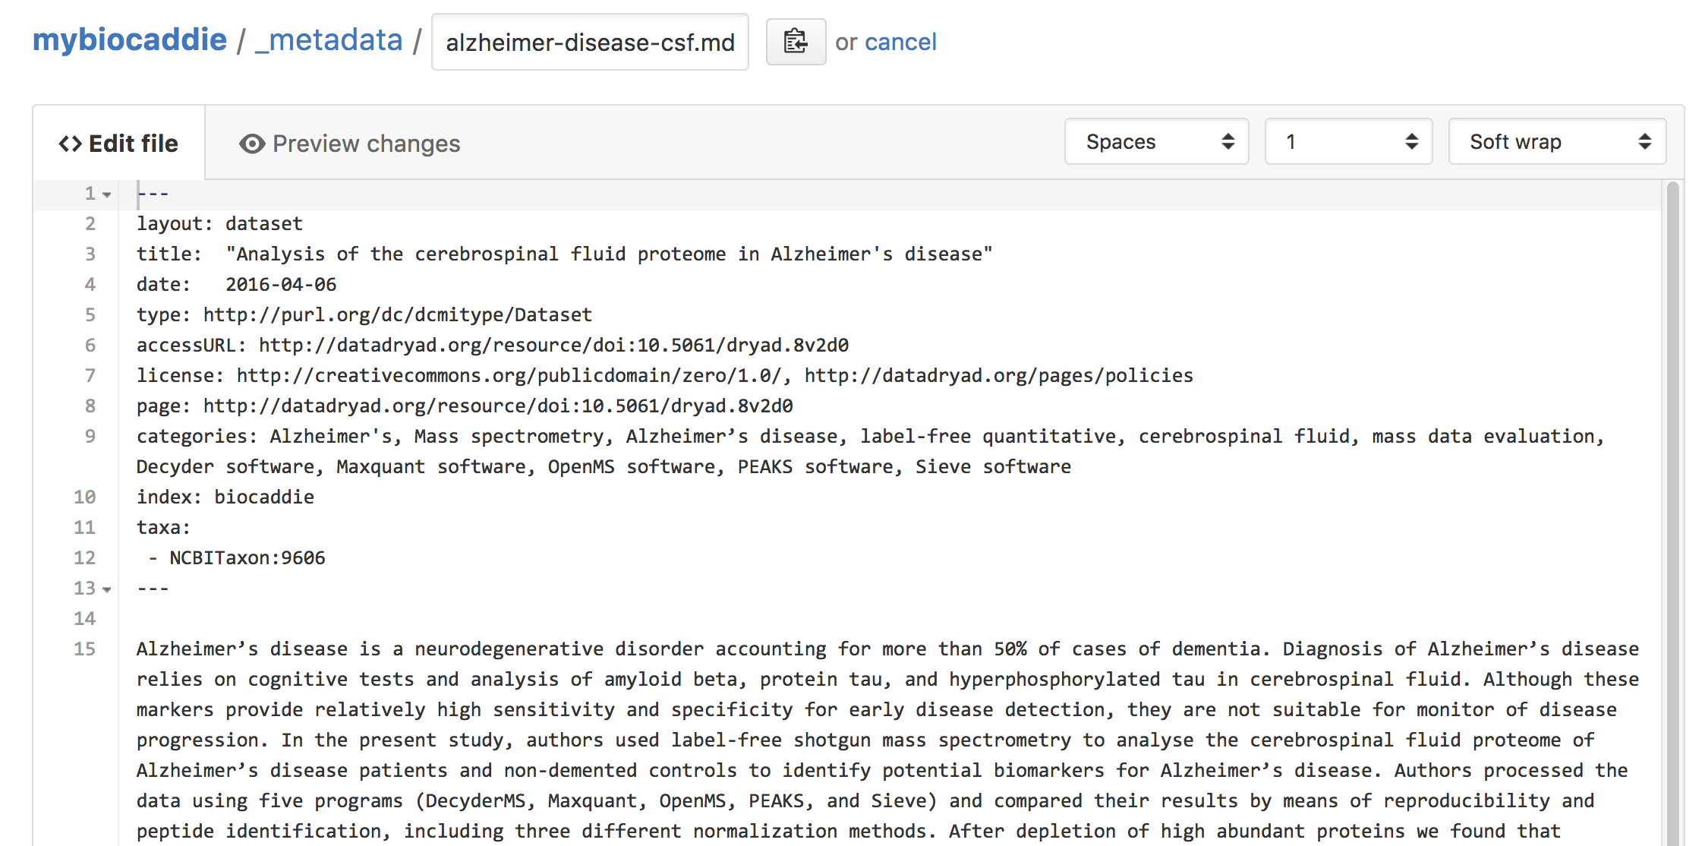

Slide 9
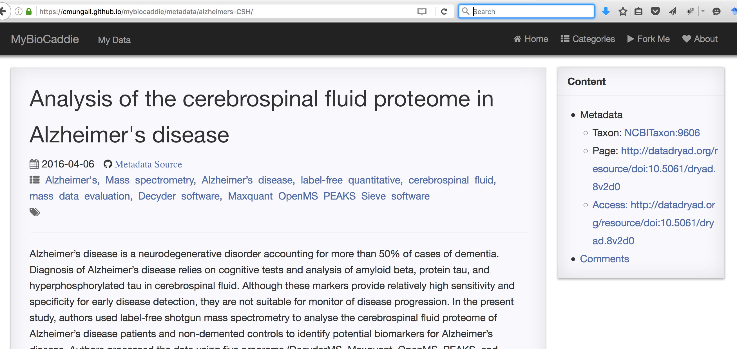
Immediate publication on personal site
https://{{YOURNAME}}.github.io/mybiocaddie/

Slide 10
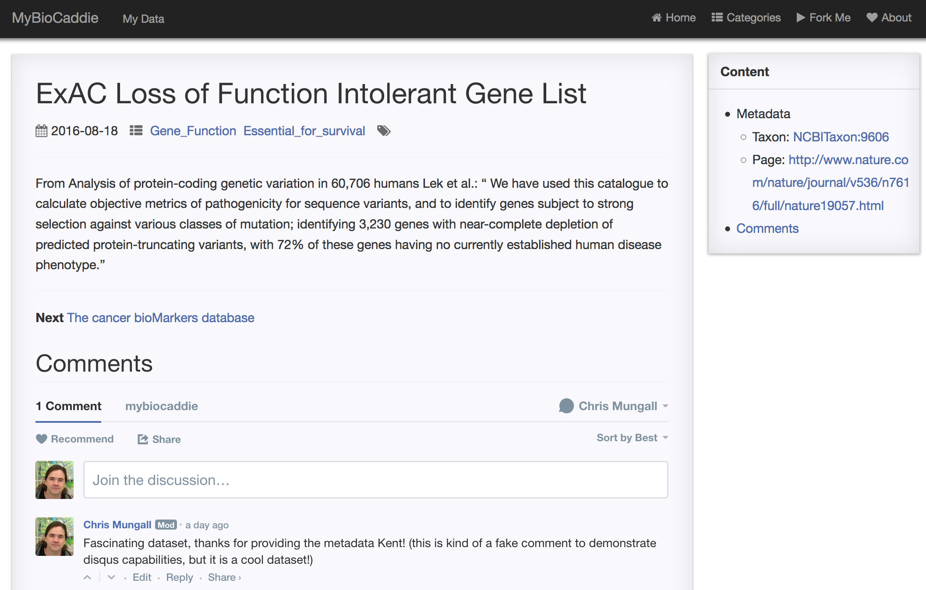
https://kshefchek.github.io/mybiocaddie/metadata/exac-lof/

Slide 11
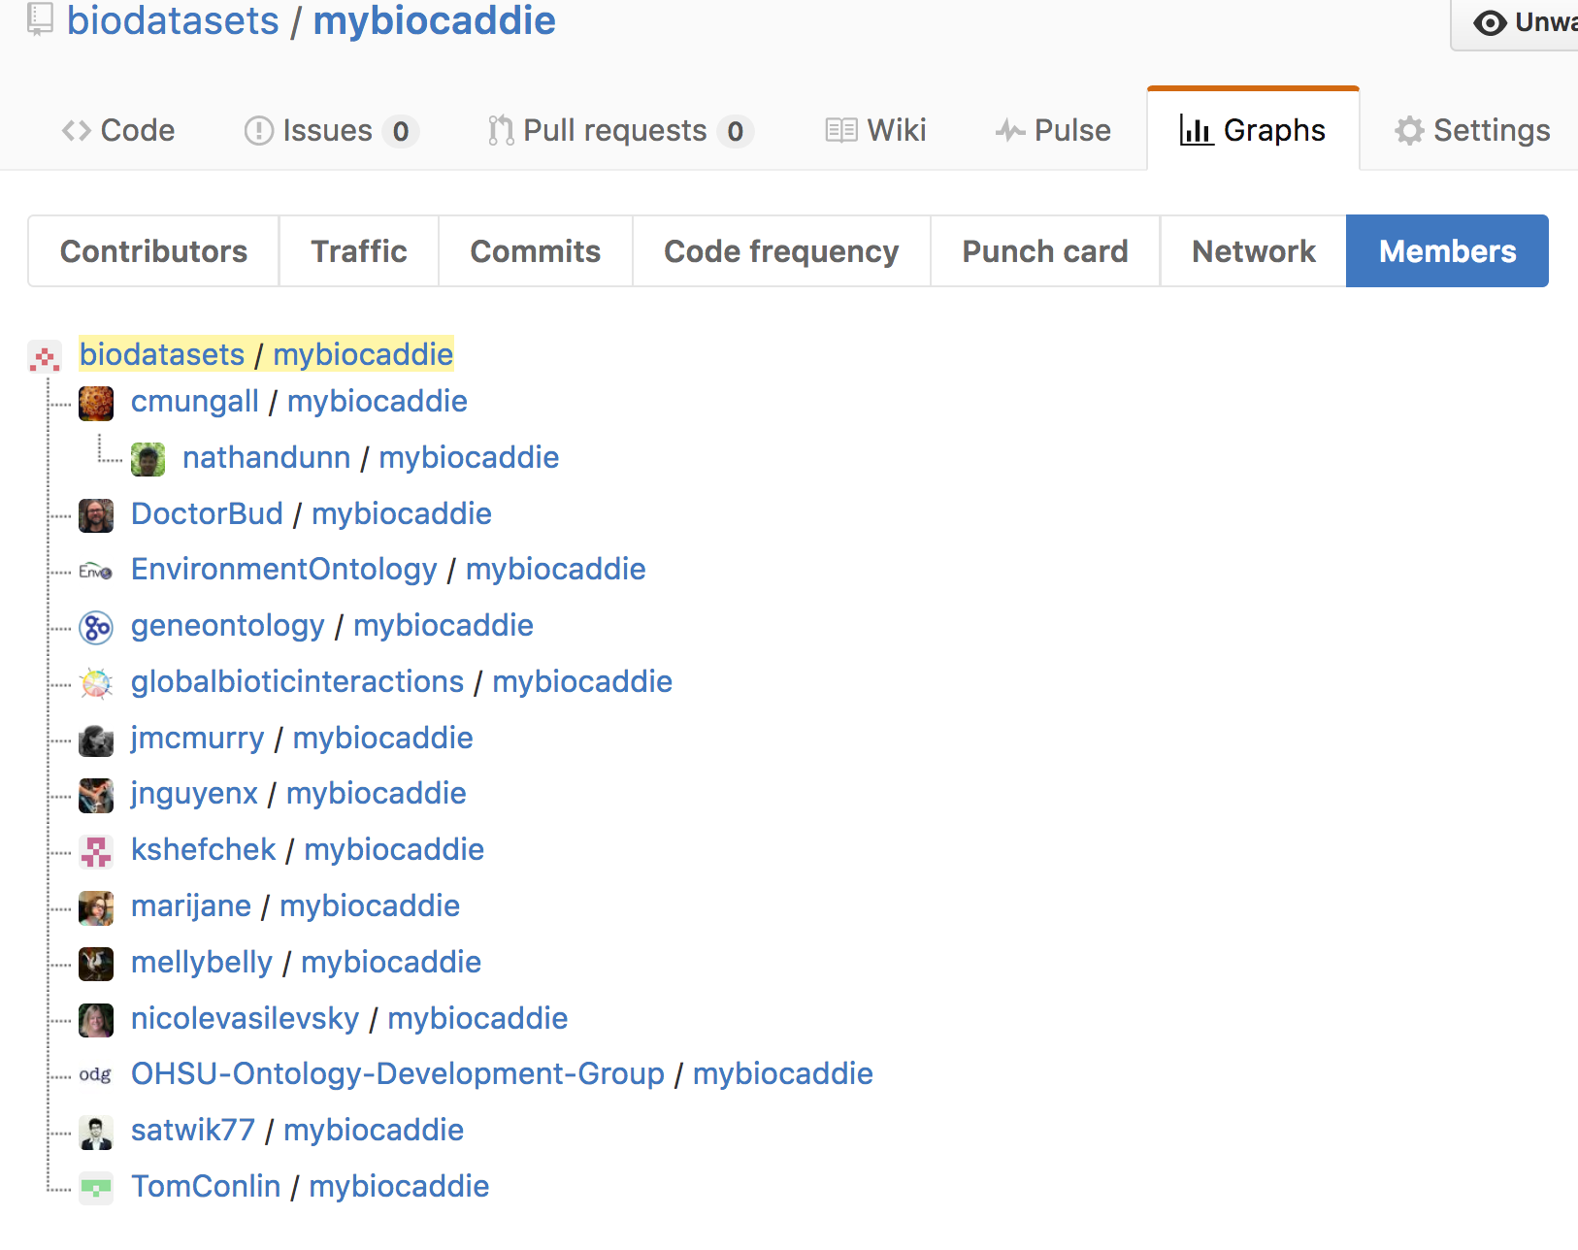
Multiple Repos –
How do we search?
GitHub API used to
search for magic
key phrase

Slide 12
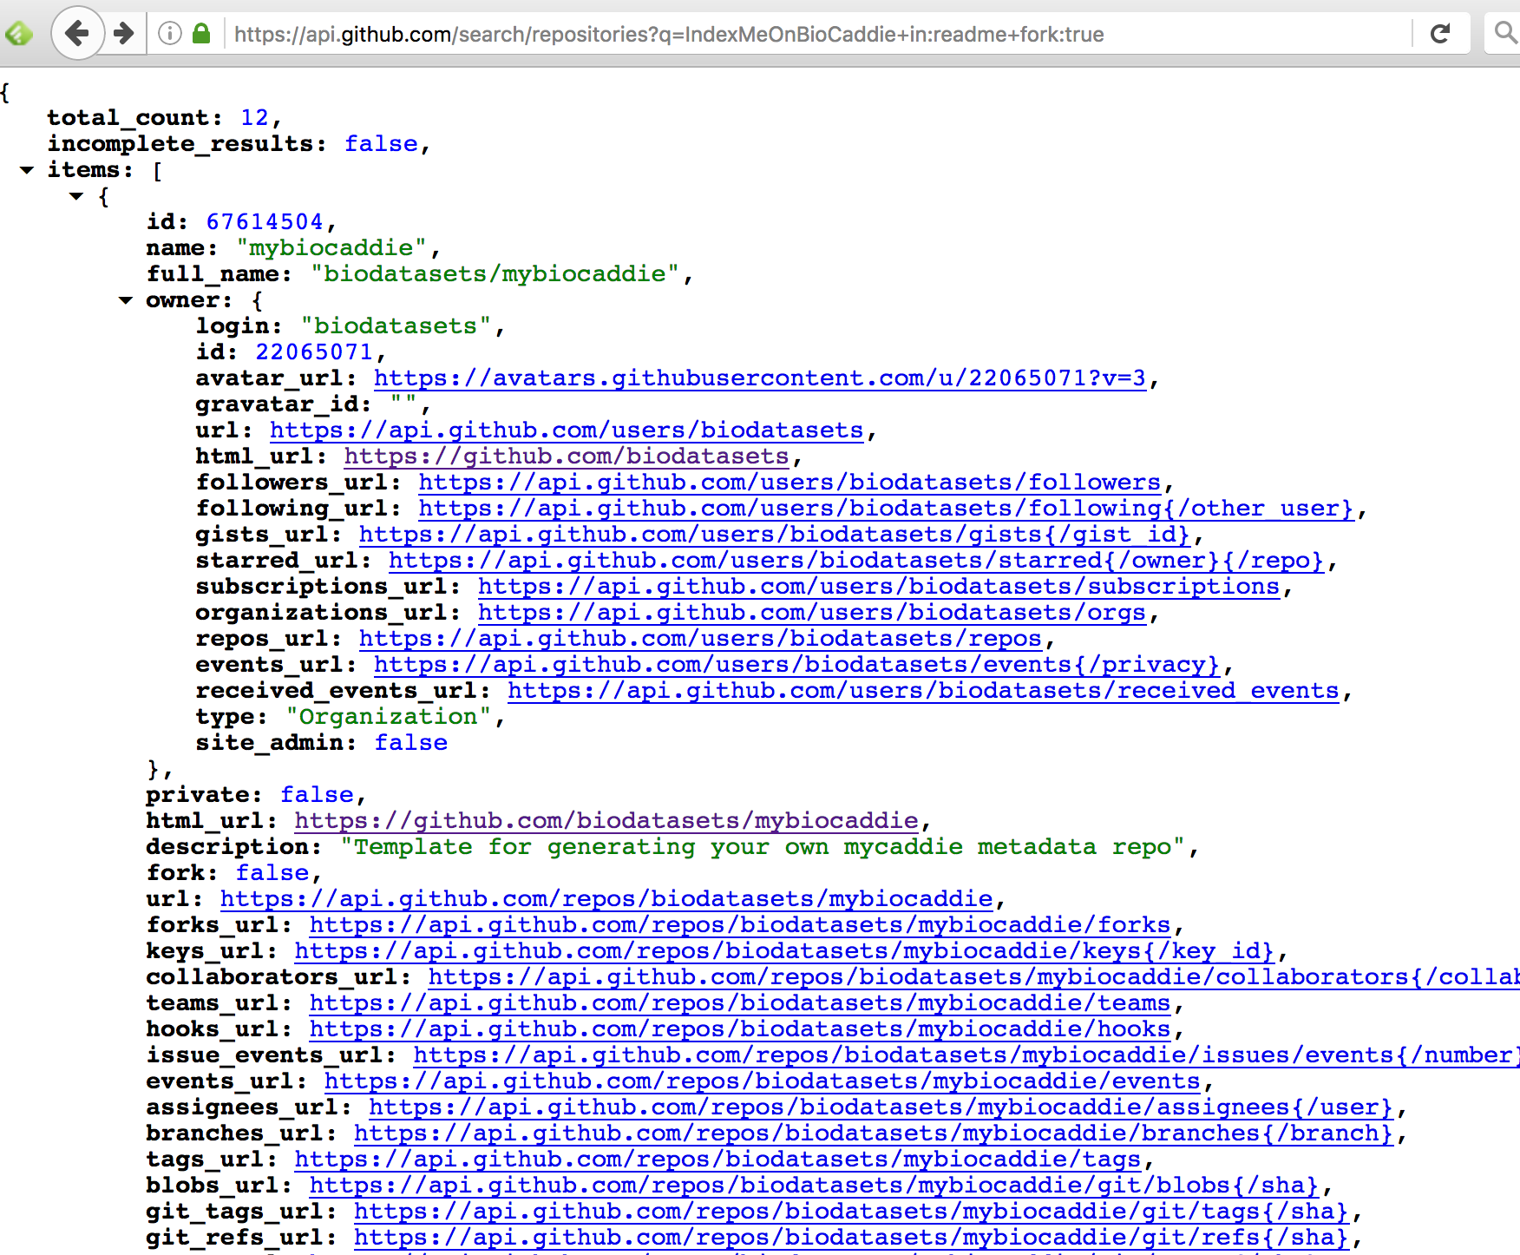
Not useful for a typical user!

Slide 13


GitHub Pages
CI
api.github.com
repo
repo
repo
…
harvester.py
blazegraph
combined yaml/json-ld
Central
JSON-LD
Context
(pfx commons)
Aggregated
repo
RDF/turtle
GitHub Pages
https://github.com/cmungall/biocaddie-gym
Notes:
This part could be replace by core biocaddie/datamed

Slide 14
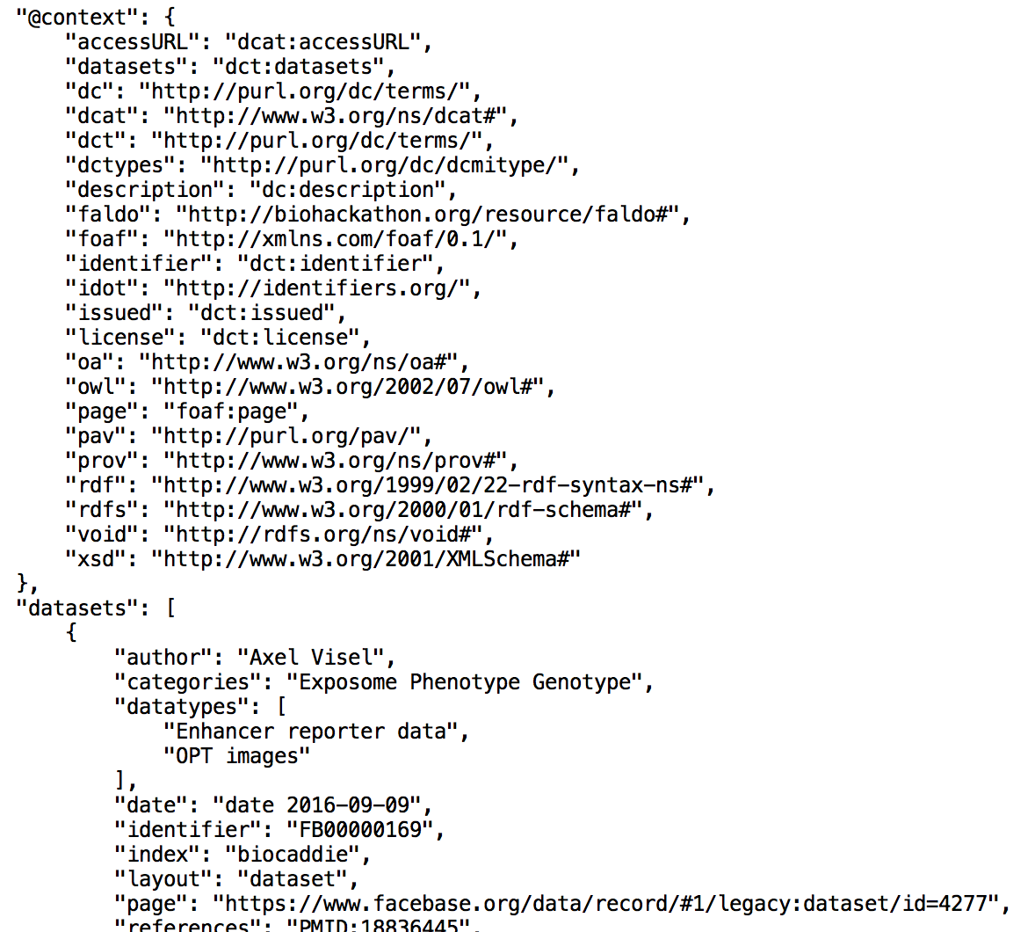
JSON files
have JSON-LD
context injected

Slide 15
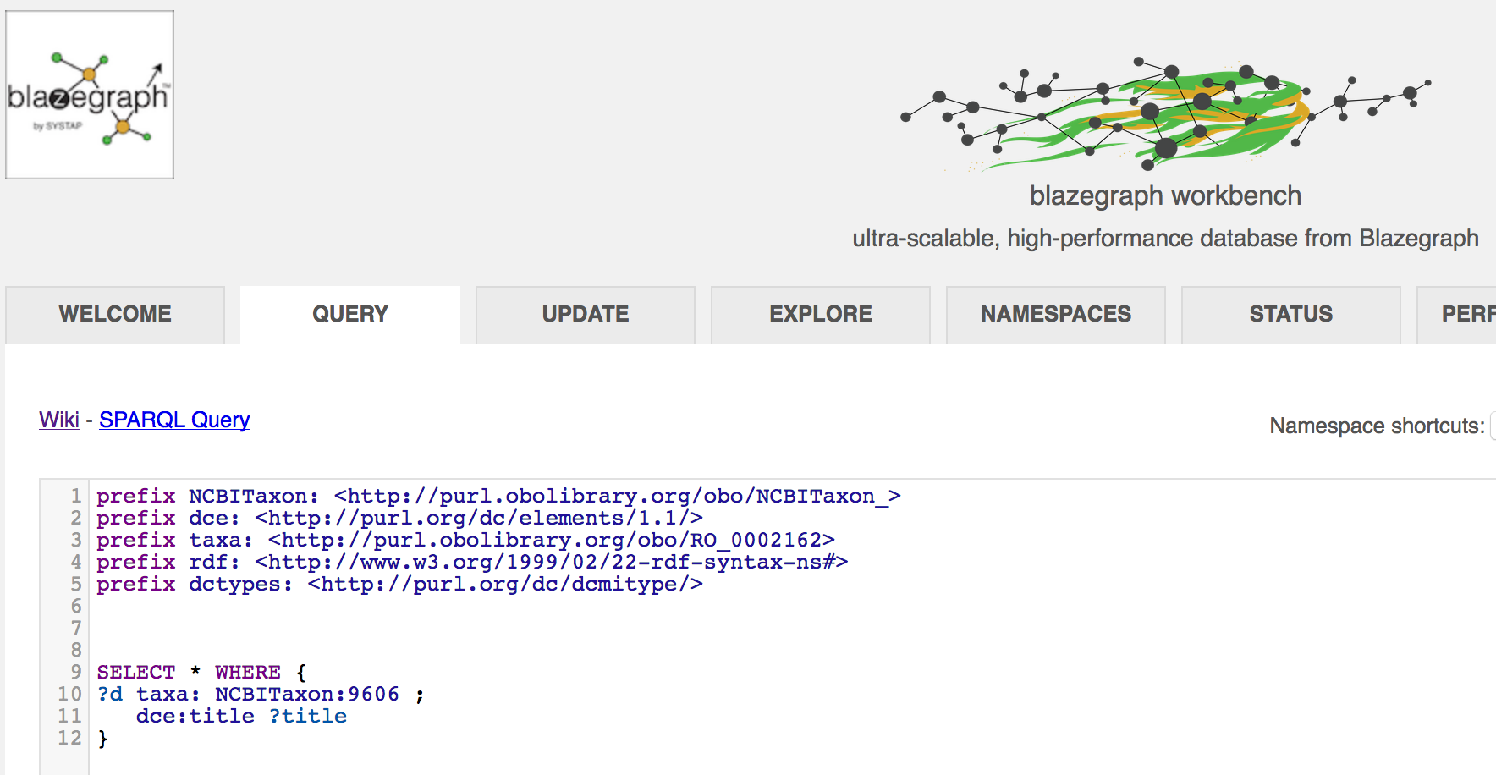

Slide 16
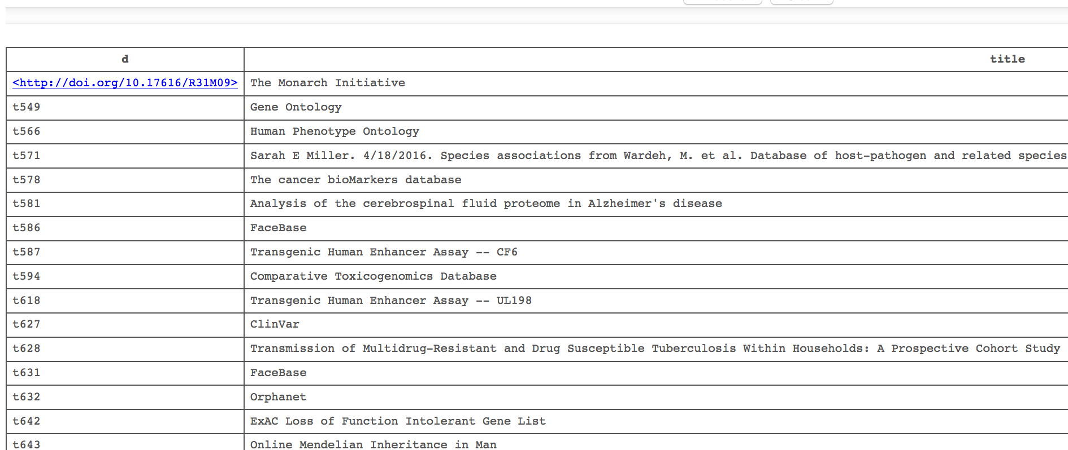

Slide 17
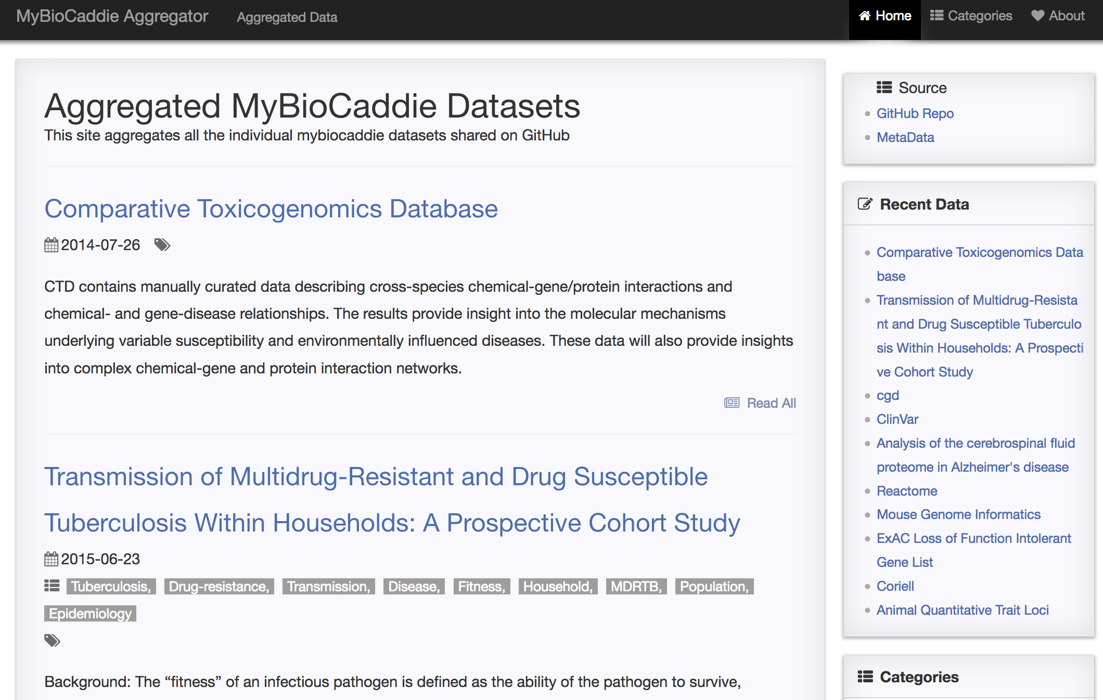
https://biodatasets.github.io/mybiocaddie-aggregator

Slide 18
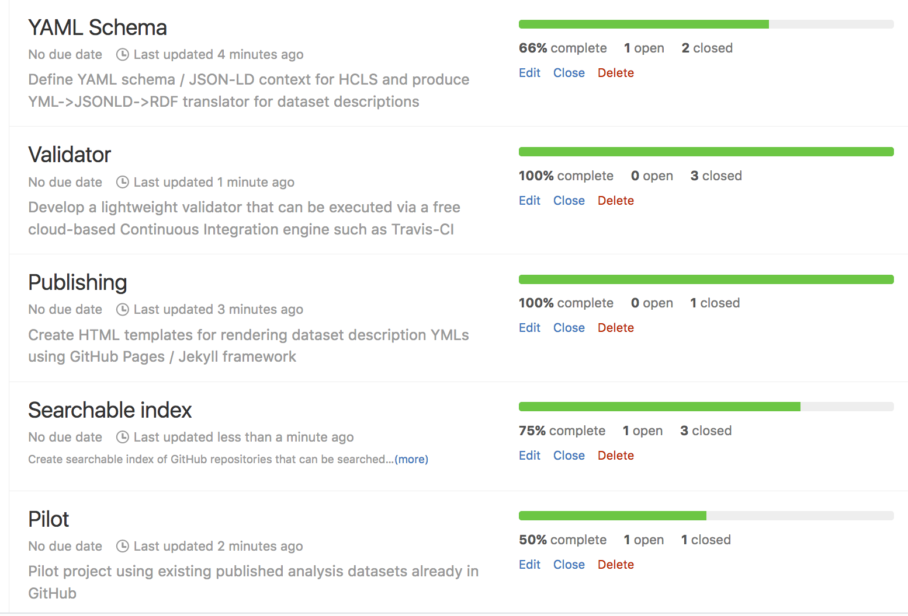
Progress on milestones

Slide 19
Finishing up pilot
YAML tags
Coordinate JSON-LD Contexts with BioCADDIE WG3
Coordinate on prefixes/ids with BioCADDIE WG2
Pilot datasets
Explore more real-world examples
Bug fixing
Categories don’t show correctly
Evaluate
What can make the process easier?
Forks can be confusing
Avoid vendor locking
E.g. ease of switching to GitLab
How to use with DataMed

Slide 20
Acknowledgments
LBNL
Nicole Washington
OHSU
Kent Shefcheck
Nicole Vasilevsky
Tom Conlin
Julie McMurry
Matt Brush
Melissa Haendel
GLOBI
Jorrit Poelen

